Slide 1
Office 365 development

Slide 2
Moving Full Trust Code to the Cloud Using Repeatable Patterns and Best Practices

Slide 3
Agenda
Why add-ins?
Add-in basics
Common Customization Scenarios

Slide 4
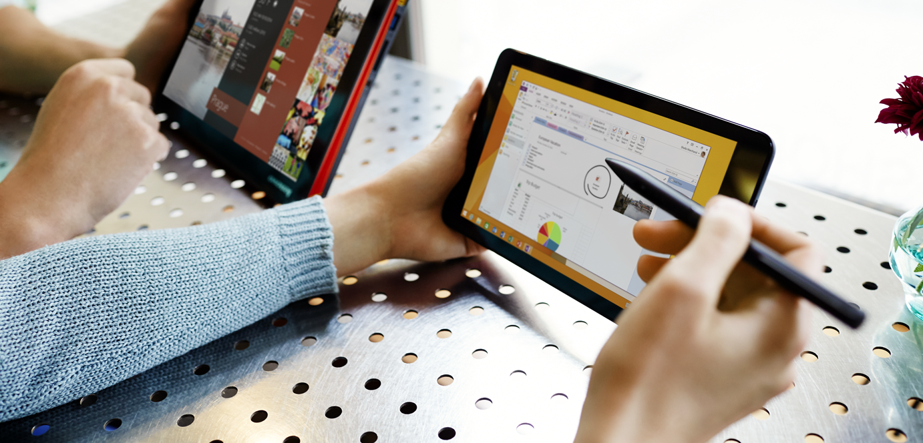

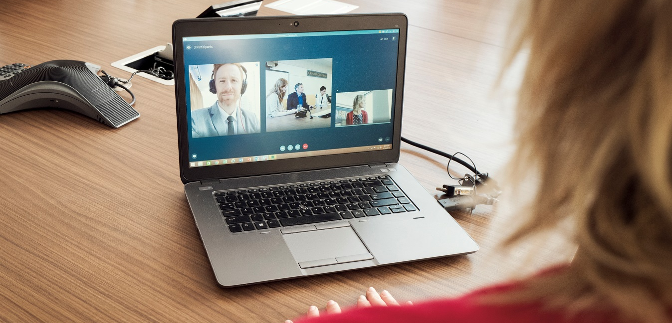
Office Platform
WHAT CAN I BUILD?
ADD-INS AND WEB PARTS:
Make your solution a native part of the modern Office
WEB AND DEVICES APPS:
Build smarter apps by connecting to Office services
VOICE, VIDEO, CONNECTORS, AND BOTS
Create the next generation of productivity solutions

Slide 5
1
Why add-ins?

Slide 6
The App Proposition…
Add-ins are decoupled from SharePoint
Add-ins run in the cloud or on the client…NOT on the same w3wp.exe as SharePoint
Add-ins can be hosted pm any web platform from virtually anywhere in the world
Reduces the friction between SharePoint Developers and IT Pros
Lightweight developer story
Traditional SharePoint assemblies are not remotable… developers required dedicated farms
Add-in developers only need a developer site collection
Customizations based on web standard
Add-ins leverage the best of HTML5/CSS3/JavaScript
Leverage any server-side web technology that can render HTML…MVC, PHP, Java
Add-ins are Discoverable
Corporate App Catalogs for private customizations and the Office Marketplace for public add-ins
Notes:
3min
STEVE

Slide 7
2
Add-in basics

Slide 8
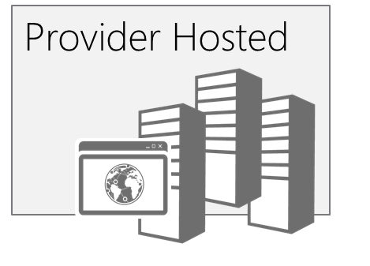
App Hosting
SharePoint
Oauth + REST or client object models
Existing sites and services
The app and all resources are hosted by the provider in any environment suitable for the app.
App web (optional)
SharePoint
hosted
Existing sites and services
The app and all resources are hosted in your organization’s SharePoint farm. Relies on client side technologies. Your IT organization supports the app.
App web
Notes:
Richard

Slide 9
SharePoint 2013 Remote API
_api is new alias for _vti_bin/client.svc
Server
Execute Query
Client
REST / OData
JavaScript Library
.Net CLR Library
Custom Client Code
Notes:
Steve

Slide 10
Surfacing Apps (User Experience)
 | Shape | Description | Example
 | Immersive Full Page App | App that implements a new scenario for customers ALL apps have a full-page experience | Resource Tracking, Budgeting
 | App Part | Provides new parts you can add to your sites | Weather, Team Mascot, News
 | Extension App | Add new actions for documents and items | Display Document Visualization, Print to Print Service Vendor
 | SharePoint Dialog | Usually used in conjunction with Custom Action, but could be scripted in page or in OOTB controls | New site, Custom Upload, Get a Tiny URL
Notes:
Richard

Slide 11
3
Common Customization Requests

Slide 12
Common Customization Requests
User Experiences
SharePoint Timer Jobs
SharePoint Delegate Controls
Site Templates and Provisioning
Notes:
.5min
STEVE

Slide 13
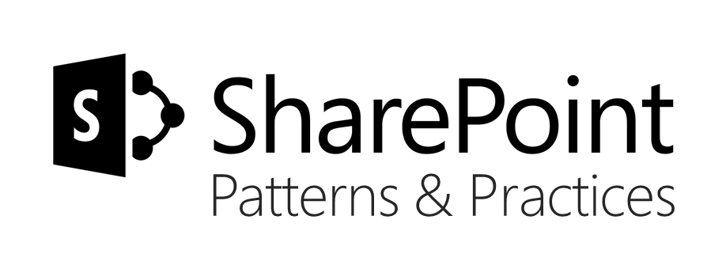
Sharing is caring…
Reusable code samples
Guidance documentation
Monthly community calls
Case Studies
SharePoint Framework
SharePoint add-ins
Microsoft Graph
Remote API access
http://aka.ms/SharePointPnP

Slide 14
User Experiences
Can provider-hosted add-ins feel like SharePoint?
Apps can leverage the Chrome Control to replicate the theme of a host web
The Chrome Control can display the host web icon and custom menuing
Will it feel like a world of iframes?
Add-in parts can incorporate the styles from the host web
Add-in parts can request to be resized by the host web by posting resize messages
What about common server-controls?
Office UI Fabric Controls for generic UI elements
Community initiatives, like SharePoint PnP, includes different kind of client side implementations for typical customizations
Notes:
3min
RICHARD

Slide 15
User Experience in Provider-hosted add-in
3 Common Customization Requests
Demo

Slide 16
Timer Jobs via add-ins
Are operations supported by CSOM?
Significant CSOM updates in 2013, including User Profiles, Social, Taxonomy, and more
SharePoint Online and 2016 have even further enhanced remote APIs
Determine Authentication Approach
OAuth approach will require a web experience to trust the app
Service Account with credentials (use SharePointOnlineCredentials in SharePoint Online)
Scheduling
Run from on-premises servers or in the cloud
Windows Azure Websites support scheduled WebJobs
Notes:
4min
STEVE

Slide 17
Timer Jobs via add-in model
3 Common Customization Requests
Demo

Slide 18
SharePoint Delegate Controls
Allow UX customization without custom master page
AdditionalPageHead delegate control is commonly used in full-trust solutions to inject customizations into an existing master page
Deployed through a CustomAction in add-in (requires high permissions)
JavaScript Injection with UserCustomAction
UserCustomAction programmatically added to host web via Add-in Installed remote event
ScriptLink location will render as a script link to ALL pages in the host web or host site collection
Notes:
2min
RICHARD

Slide 19
JavaScript embedding with user custom action
3 Common Customization Requests
Demo

Slide 20
Site Templates and Provisioning
The Power of Provisioning
Programmatically owning the site provisioning process enables you to do anything to a site that CSOM (or external APIs) support
Apps don’t support site definitions, provisioning providers, or feature stapling, but the same result can be achieved
Have a look on PnP Site Provisioning Engine
Code based templates, which can be also serialized to XML or JSON for storage
Can be used with managed code or by using PnP PowerShell cmdlet’s
Great community starter kit available as PnP Partner Pack, showing different capabilities as a one solution
Notes:
10min
STEVE

Slide 21
Site templates and provisioning
3 Common Customization Requests
Demo

Slide 22
Agenda
Why add-ins?
Add-in basics
Common Customization Scenarios

Slide 23
Further reading…
SharePoint Code Samples
SharePoint Training videos & hands on labs
SharePoint documentation
SharePoint Patterns and Practices solution guidance

Slide 24
Engage

